Slide 1

DBMS PROJECT
Car Showroom Management
CHETHAN S, ENG22AM0084 GUDLA MONISH, ENG22AM0096 MATHEW ALEX, ENG22AM0113 NV KUSHAL, ENG22AM0116

Slide 2
Why this project
Real-World Relevance:- Car management systems are essential in industries such as car dealerships, rental agencies, and service centers. This makes the project directly applicable to real-world business scenarios, enhancing our understanding of practical database applications
Complex Data Relationships:- The project involves managing complex data relationships between cars, customers, sales transactions, and maintenance records. This complexity provides an excellent framework to demonstrate our ability to design and manage a sophisticated database system
Comprehensive Learning Experience:- Developing this system allows us to apply a wide range of database management skills, including database design, SQL, query optimization, and transaction management. It offers a holistic learning experience that covers both theoretical and practical aspects of database systems

Slide 3
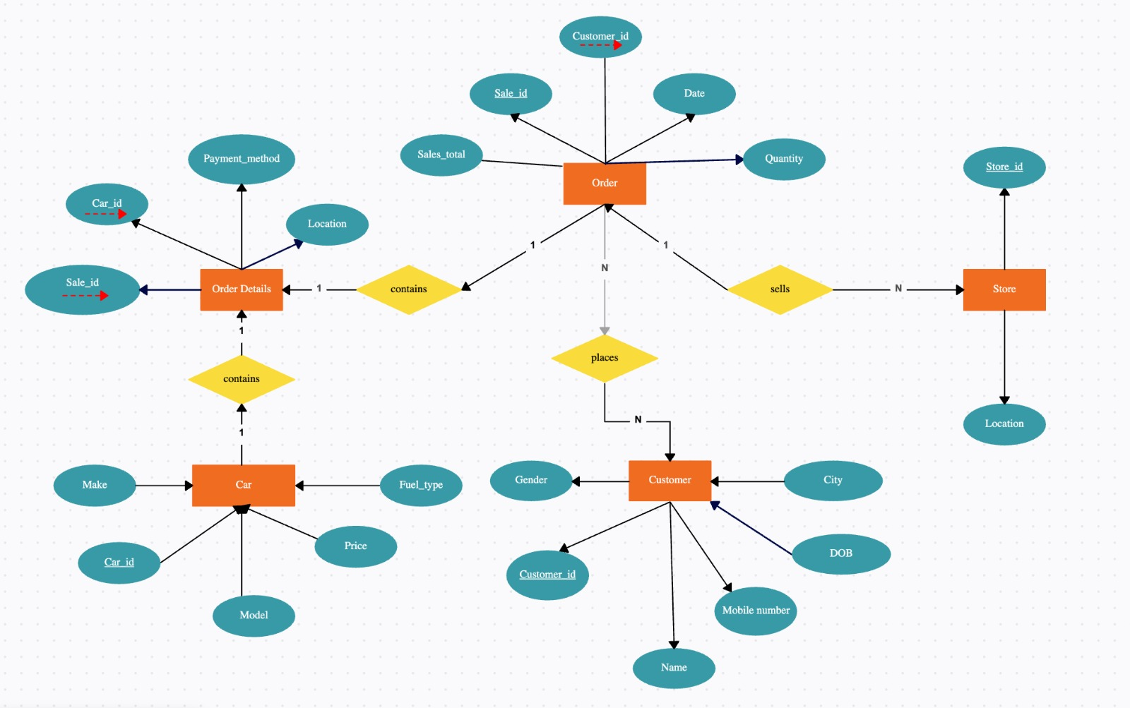
ER diagram

Slide 4
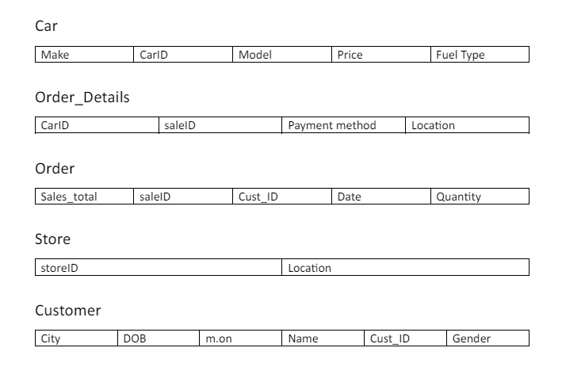
SCHEMA

Slide 5
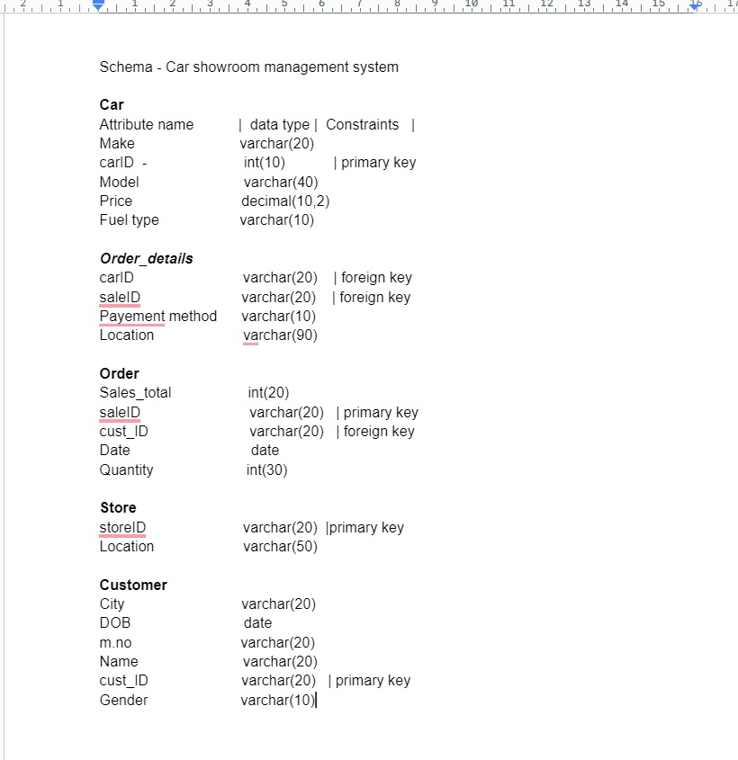

Slide 6
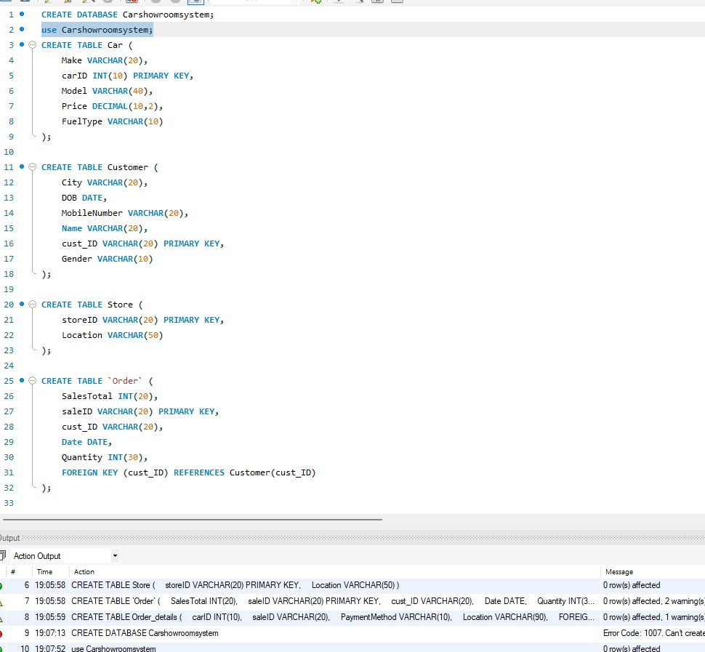
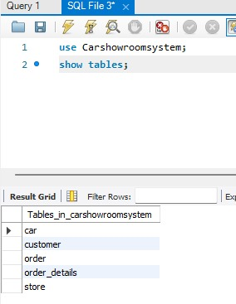
MYSQL code

Slide 7
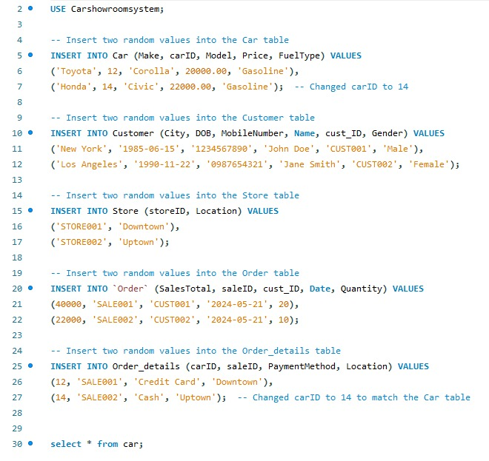
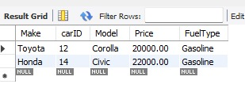
Code Implementation

Slide 8
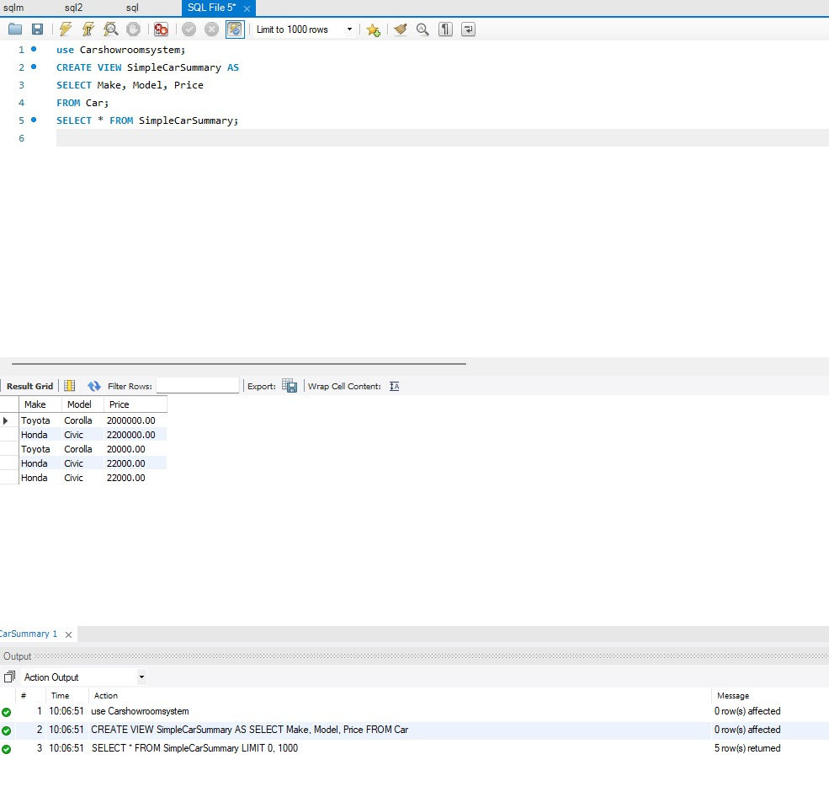

Slide 9
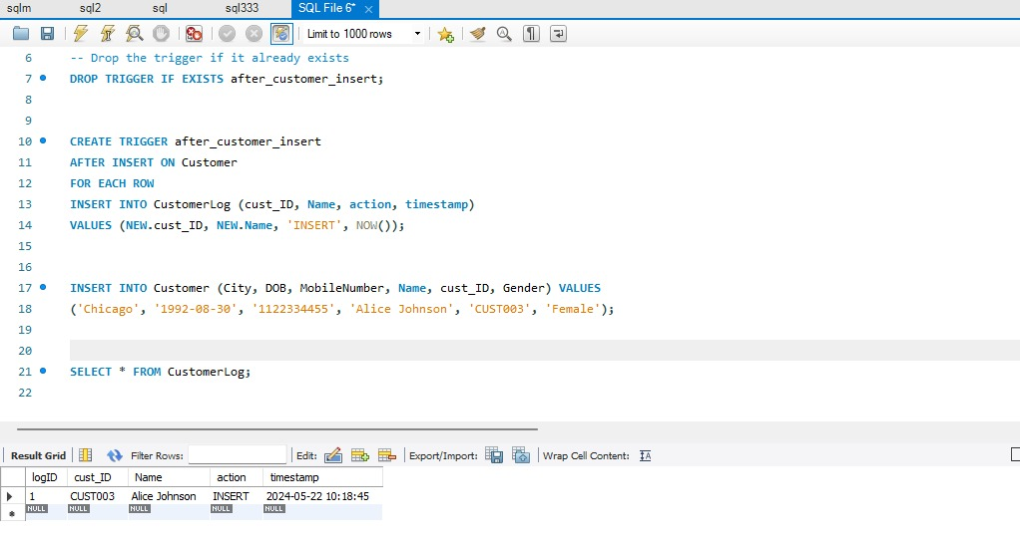

Slide 10
